Slide 1

Real Estate Price Analysis
Exploratory Data Analysis and Prediction
Unveiling insights and predicting housing prices in California
BA
by Besher Alashkar

Slide 2

Introduction
Analyzing California housing prices with machine learning
Predictive model for informed real estate decisions

Slide 3
Objective
Predictive Model
Data Exploration
Visual Insights
Reliable prediction of housing prices
Discover insights through data engineering and analysis
Interactive visualizations for clear understanding

Slide 4
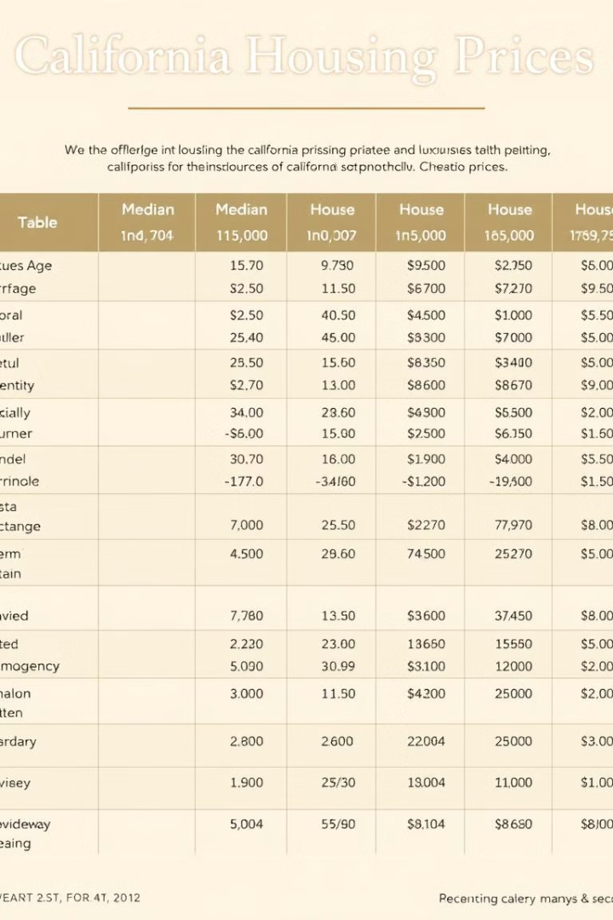
Data Overview
1
California Housing Prices
2
Key Features
Median Income, House Age, Proximity to Ocean
Kaggle dataset, over 20,000 rows
3
Target Variable
Median House Value

Slide 5

Methodology
1
Data Engineering
Cleaning, transformation, splitting
2
Exploratory Data Analysis
Analyze relationships and trends
3
Modeling
Evaluation, selection, and final model

Slide 6
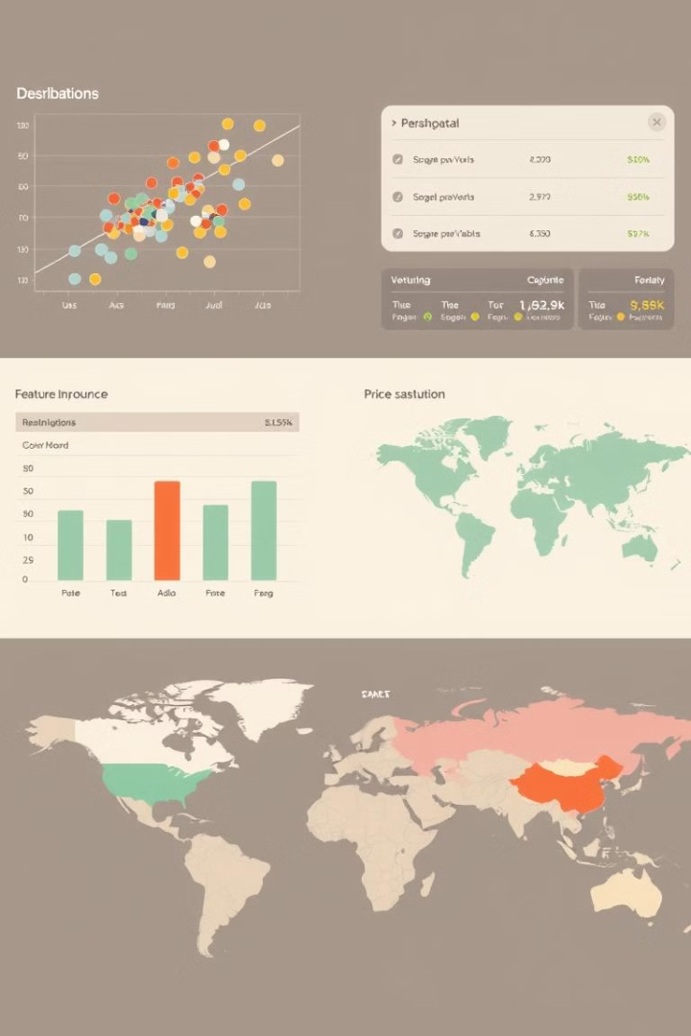



Key Findings
Median Income
Proximity to Ocean
Strong predictor of house prices
Significant influence on values
Random Forest
Best accuracy, RMSE = 51,295.38

Slide 7
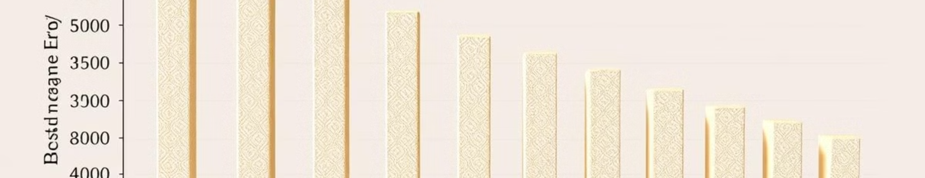
Other Models Evaluated
SVR
Ridge Regression
RMSE = 72,701.10
RMSE = 81,565.81
Linear Regression
Random Forest
RMSE = 82,000.00
RMSE = 51,295.38

Slide 8
Recommendations
Data Enhancement
1
Uncapped housing prices, neighborhood quality
Advanced Models
2
Gradient Boosted Trees, XGBoost
Real-Time Deployment
3
FastAPI, Flask

Slide 9

Conclusion
Reliable model for predicting housing prices
Actionable insights for informed real estate decisions
Foundation for future advancements and deployments

Slide 10
Thank you for your attention !
I’m Happy to answer any questions you may have.

